Slide 1
UCSB Nanofabrication Facility College of Engineering
Identifying and Implementing Operational Changes for Multi-User Lab Operation During COVID-19
Brian Thibeault, Technical/Operational Director
Jonathan Klamkin, Faculty Director
With contributions from the Staff:
Demis, Tom, Aidan, Mike S, Tony, Lee, Brian L, Don, Mike D, Luis
www.nanotech.ucsb.edu

Slide 2
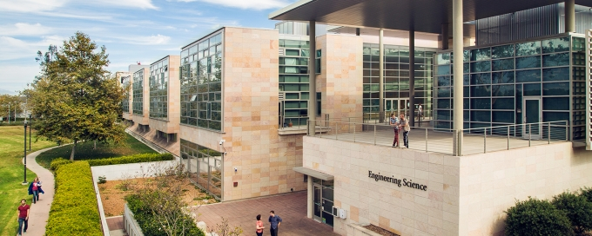
UCSB Nanofabrication Facility (Nanofab)
Nanofab occupies the entire ground floor of the main Engineering Sciences Building (ESB)
The Nanofab is a state-of-the-art university nanofabrication cleanroom facility and considered one of the most advanced and highly used in the world.
Critical facility for 50+ UCSB research groups
Critical infrastructure for High Tech Business Community (~50% of users non-UCSB)
Includes DOD critical/essential workers and medical device businesses
Estimated 500+ jobs outside of UCSB depend on the Nanofab

Slide 3
The Facility Numbers to Consider For Operation During the COVID-19 Pandemic
The Nanofab is a high occupancy facility
35+ users present in the lab at peak time per day
80+ users access per day, often entering/exiting multiple times throughout
(40+ on weekends)
10+ users present in high use bays during peak hours
140+ different users per week
225+ different users per month
500+ different users per year
250+ lab person hours/day during weekdays; also open evenings and weekends
Hundreds of different process flows
Dense office area for staff
The Nanofab is financially supported by user fees and >50% of normal use is required for financial stability, therefore it was imperative for us to learn quickly how to operate in the pandemic to ensure the survival of one of UCSB’s most important laboratories.

Slide 4
Modified Protocols for Essential Research Activities
Following UCSB research shutdown, the Nanofab was granted permission to open under very limited access under detailed modified protocols
The protocol plan was put together by the Nanofab Directors and Staff. This plan was reviewed with the Office of Research and the College and put into action.
A small set of authorized users was established, that included COVID-19 related research and DOD critical work
The extensive protocols were shared with the authorized users and their advisors/supervisors. Eventually the users were required to sign an agreement stating that they reviewed and understood the protocols, and agreed to follow them.
The protocols require users to measure their temperature at home before coming to the facility, not come should they have a fever or have any virus symptoms, not carpool with any colleagues or other users, and notify the Nanofab Facility Director immediately should they have any symptoms or test positive for COVID-19

Slide 5
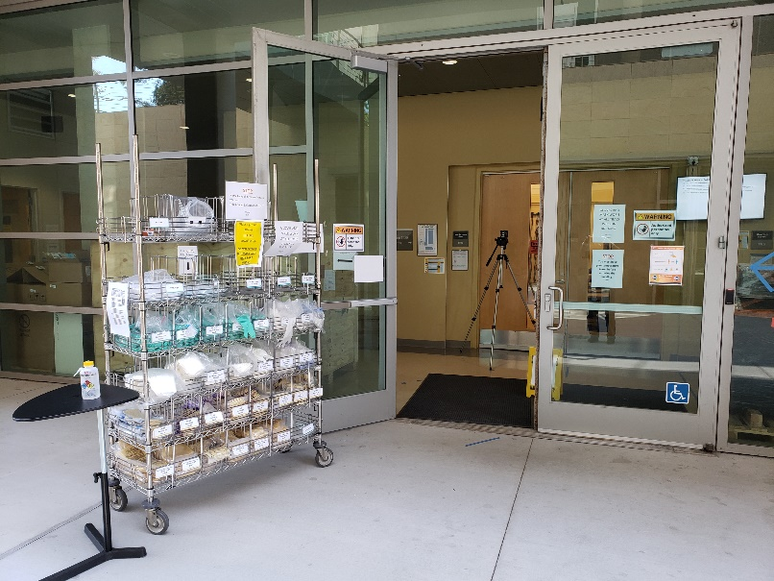
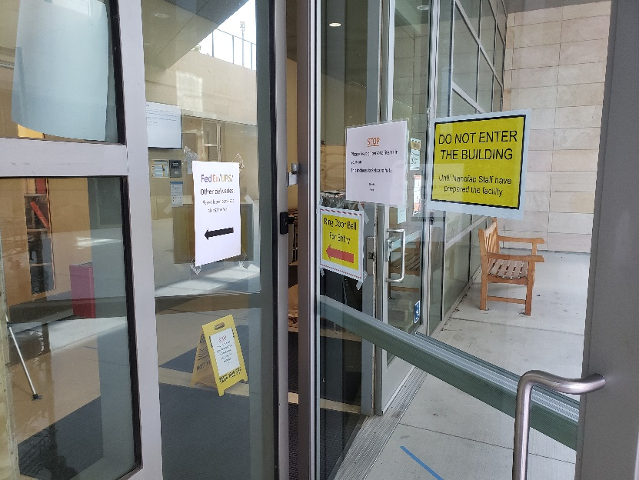
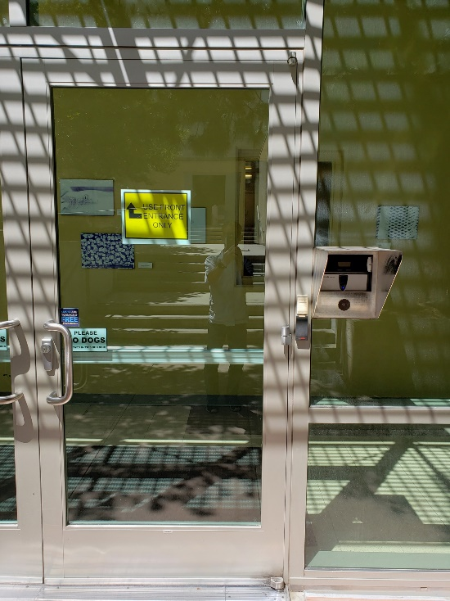
Modified Entry Way During Limited Access
Doors propped open during start of each shift
Rack outside stocked with gloves and masks for entry
Signage to reminder users of policies
Thermal imager for body temperature scanning
70% isopropanol and clean wipes for cleaning items and hands
Outside of shift start, doors are locked
Signage directs users to contact Staff using doorbell
Signage for Fedex/UPS deliveries directs to drop off location for non-signature deliveries
Sign at side door directs users to main doors

Slide 6
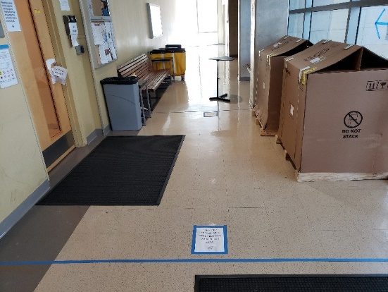
Modified Entry Way During Limited Access
Iris scanner for unlocking door to gowning room
Scanner also logs user presence and hours in cleanroom
After unlocking, door can be pushed open with body to avoid touching door handle
Lines marked on floor for keeping iris access area clear – 6 feet of space
Users able to look through window to ensure there is no user inside before entering into gowning area, otherwise they wait

Slide 7
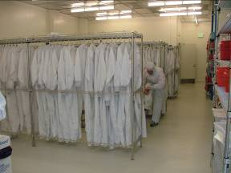
Gowning Room for Entry and Exit
370 hangers for reusable, washable gowns
Demonstrates the usage – most hangars full under normal operation
Gowning room is large allowing for ~4 users at one time
Forced air from ceiling
Touching gowns in adjacent hanger slots not acceptable
→We began with gown re-use and placed gowns with 3 spaces between
→We transitioned to single-day gown use requiring more frequent laundering of gowns

Slide 8
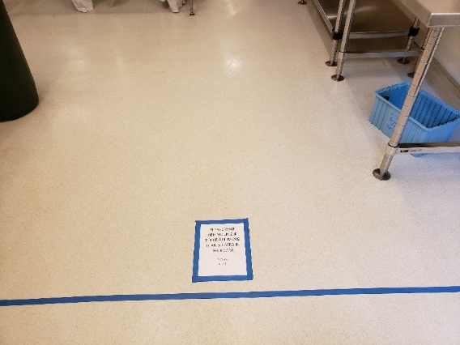
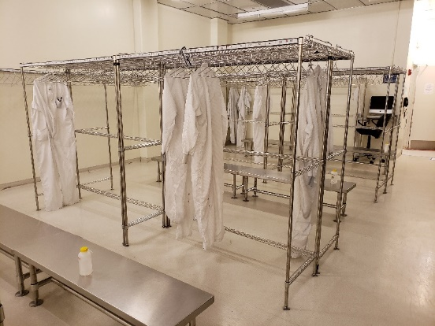
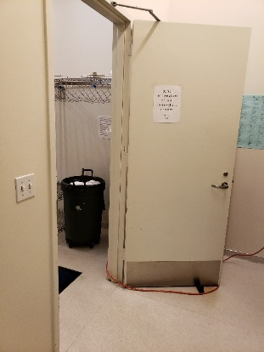
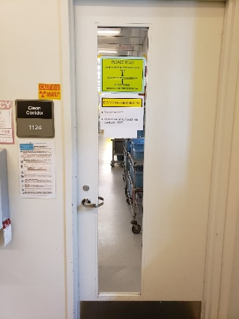
Gowning Room for Entry and Exit: Modified
Lines and signage to remind users entering or exiting of the maximum number of allowable users in the gowning area
Transitioned to single-day use for washable gowns
Exception for 4XL and 2XL gowns hung due to lack of supply currently
70% isopropanol and wipes available for bench cleaning by users after gown/degown
Extensive cleaning by staff between shifts
Sign to reminder users to keep inner gloves and mask on when exiting cleanroom
Sign to remind users of double-glove policy and to wipe surfaces they come in contact with following use

Slide 9
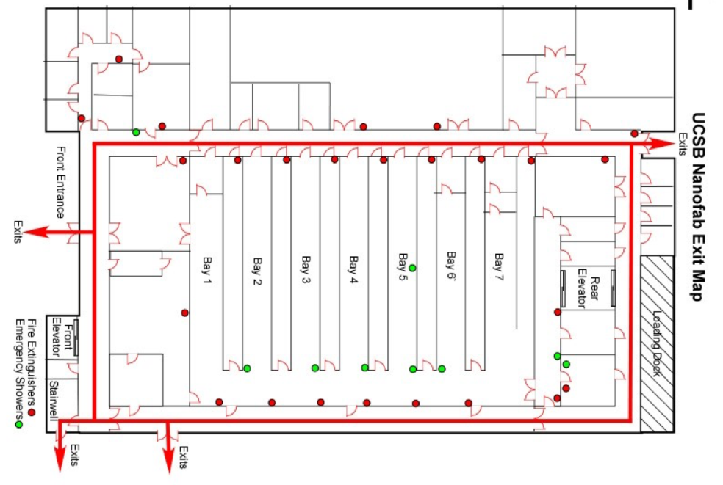
Inside: Nanofab Cleanroom Facility Floor Plan
Access is controlled by an iris scanner and card system
Large gowning area for dressing in gowns and applying PPE
~13,000 ft² cleanroom
5X Class 1000 bays, 2X Class 100 bays
Chases for maintenance and support equipment
Some isolated rooms for specialty equipment
Bays are 60 feet long x 13 feet wide.
Staff Offices
STAFF ONLY
Nanofab Facilites
Staff-Service Only
QFI
North Hallway – Staff-Service ONLY
Maint.
Staff Only
Dice
Gown
South Hallway – Users to Dicing

Slide 10
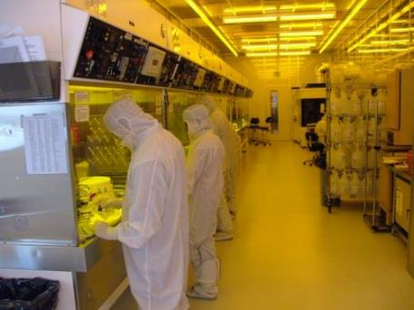
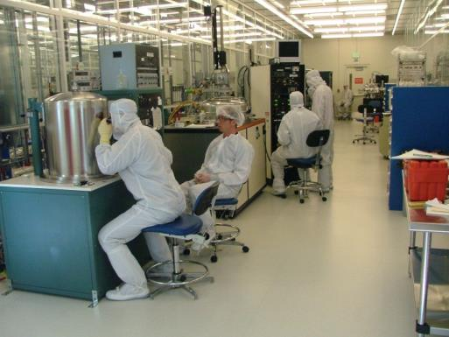
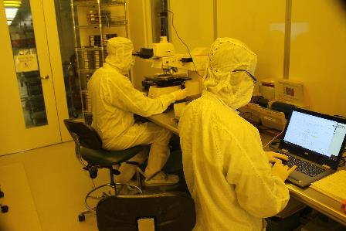
Observations During Ordinary Operation Before Pandemic
1-2 users per 2-station 6 ft. bench → need to transition to 1 user per bench
Faces come in close contact with hood sashes → need to clean between uses
Lab chairs occupy floor space → better to minimize lab chair use to minimize items contacted and ensure spacing
Users touch controls and sit very close to them → requires cleaning between use
Sometime 2 users working together at one piece of equipment → need to eliminate or modify to ensure social distancing
No training at present
Microscopes have eyepieces, chin rest, knobs that are contacted: → can eliminate/minimize use of eyepieces by using digital camera and monitor → clean between uses
Users often bring personal laptops and other items → eliminate any unnecessary items and require additional cleaning of these before entry

Slide 11
Carefully Understand Space to Establish A Plan Nanofab Details
Air exchange environment: Nanofab main lab space capable of 2-5 air exchanges/minute
Laminar flow system with forced flow from ceiling fans to ground, exhaust through benches, and chases between bays and at many systems. 60,000 cfm exhaust.
Positive lab pressure environment
Fume hoods are laminar flow, negative pressure. These have the highest exchange rate.
Hoods are 6-8 ft long, therefore allowing only one person per fume hood
Equipment Spacing: Most tools are spaced by more than 6 feet. This could allow for full access to each tool (one person per tool), however, user flow and movement may not allow for this.
SEM Room: 2 SEMs that are less than 6 feet apart, therefore one SEM user max
EBL room: Generally used by one person.
Dicing Room: One person in the room only.
QFI Test Room: One person in room only.
Chases and service area: Typically only staff, 1-2 people.

Slide 12
Carefully Understand Space to Establish A Plan Nanofab Details
Workflows need to be considered in the lab.
What do users touch with their hands?
Doors for entering, keyboards, microscopes, tables, sashes in hoods, equipment controls.
What do users bring their faces in near contact with?
Sashes in hoods, monitors on equipment, eyepieces in microscopes, vacuum system viewing ports, equipment controls.
How do users move around when doing research work?
Walking down corridors, moving back and forth between benches and chemical cabinets, moving from system to system, sitting at microscope stations, sitting at systems to observe processes.
Put plan into action, carefully observe, make revisions
Following implementation, significant observations made including monitoring of total number of people in lab, movement of users, behavior of users, etc.
Revisions and improvements to protocol and laboratory continuously made including location of equipment to allow for further social distancing

Slide 13
Carefully Understand Space to Establish A Plan Nanofab Details
Space outside of and near lab including common areas
What doors do people use?
Transitioned to one common entrance and keeping doors propped open for entry/exit time slots with Staff monitoring and assisting with entry/exit
Where are the bathrooms?
All users are accessing bathrooms one floor above the Nanofab. The stairwell doors are propped open and the main bathroom doors are propped open.
Should any areas be closed off to user access?
The Staff office area and conference room is closed to users. The North hallway and maintenance areas are closed to users.
Where do users sit or congregate?
There are benches inside the lab, and outside for use during breaks. We have limited to one person per bench.

Slide 14
Carefully Understand Space to Establish A Plan Nanofab Details
Office space, office work, and remote work
Our Staff offices are small
Under our limited operation, we have limited to one Staff per office area
Most of the Nanofab staff work is lab-related work.
Work from home is minimal including website maintenance and procedures write ups
Shifts are required for safe practices and social distancing
We initially implemented two shifts and distribute the Staff with no cross-shifting
3 equipment engineers and 2 process engineers were assigned to each shift
Engineers at home are available for support
What else productive can be done from home?
Remote help can be provided by phone, LogMeIn, and other video conferencing
These practices have already been utilized for support outside of business hours

Slide 15
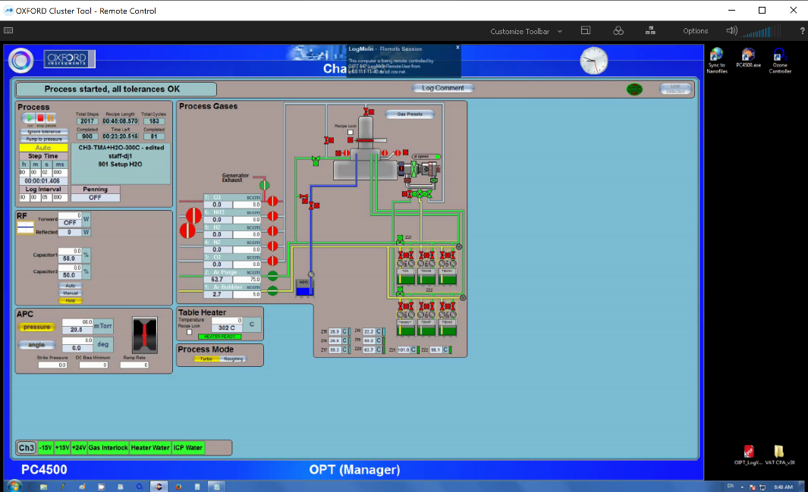
Example User Interface Accessed Remotely
Atomic Layer Deposition system
Ability to control the system and chat with users
Ability to observe user actions during operation
Can also communicate with user on phone or by video conference simultaneously

Slide 16
Carefully Understand Space to Establish A Plan Nanofab Details
Gowning protocol for cleanroom entry
Need efficient way to get people in and out
Maintain distancing, minimize interactions, but ensure throughput
What is touched?
Benches, wire racks, doors, tables
How do people enter and exit, and move within the gowning room?
Entry: Enter, leave personal items on rack, hang coat. Get new gown, boots, hood. Go to bench and suit up. Add gloves near cleanroom door entrance prior to leaving gowning area and entering cleanroom space.
Exit: Enter gowning from cleanroom, remove gown, boots, drop in laundry if needed. Remove gloves, take personal items, exit.
Where are there flow bottlenecks? Do we need to move anything to make flow better? Other protocol changes needed as well?
Example: Moving laundry bin to different location assisting to reduce a flow bottleneck

Slide 17
Carefully Understand Space to Establish A Plan Nanofab Details
Social Distancing Protocols: reduced total occupancy and limits for each work area
Users per bay:
Started with 4 users to be conservative (bays are 60 ft. x 13 ft.)
Observed that 5 users is comfortable for most bays
Posted signs to remind users of protocols
Actively reminding users of importance to adjust work behavior
Relocated some equipment:
Example: Microscopes moved to facilitate more users and distancing
Adding physical barriers
Adding plexiglass throughout lab to accommodate higher numbers
Physical barriers allows for reduced physical distancing
Assessing other physical limitations
In the process of removing some chairs, moving workstations for tools
Recapturing floor space for better distancing

Slide 18
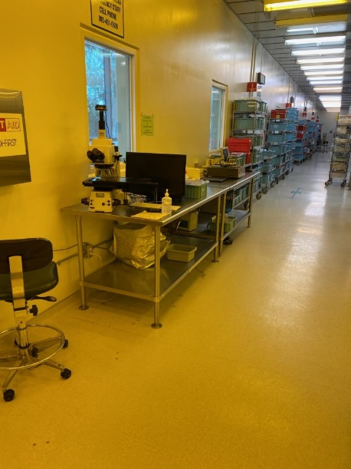
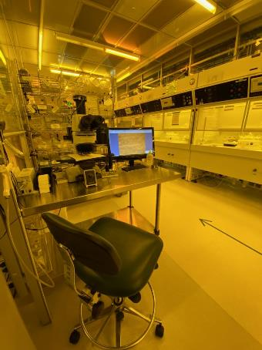
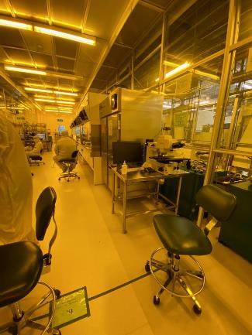
Microscopes Relocated to Recapture Floor Space and Increase Distancing of Users
Microscope against wall to clear hallway space
Microscope against wall to clear space and separate from bench users
Microscope rotated to be against wall and separated from user area for nearby stepper tool

Slide 19
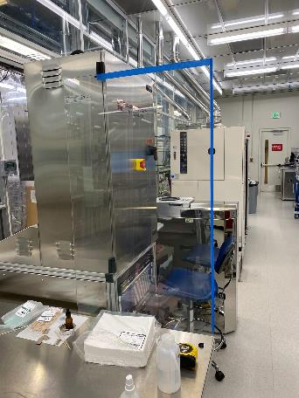
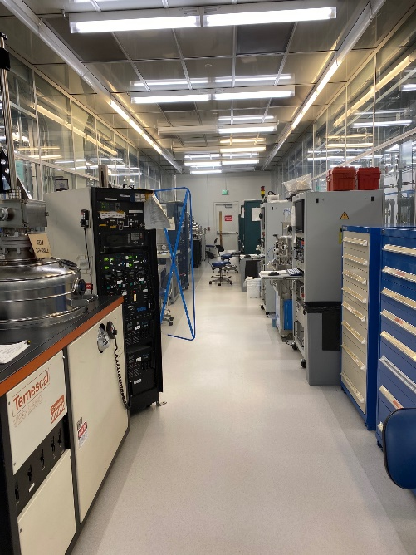
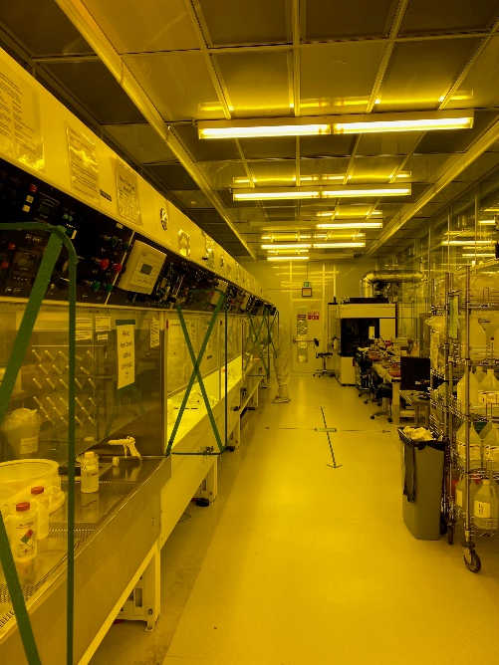
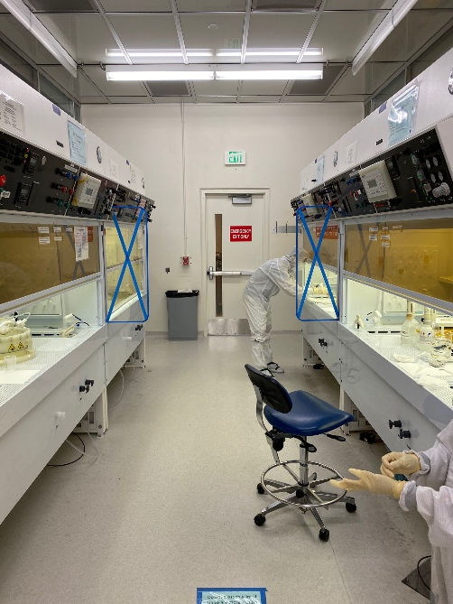
Adding Physical Barriers
Physical barrier between pieces of equipment (DSE and Pan1)
Also EB3 and EB4
Barrier between benches
X marking ensure users don’t hit barrier accidently
ESD rated plexiglass used
Between all benches

Slide 20
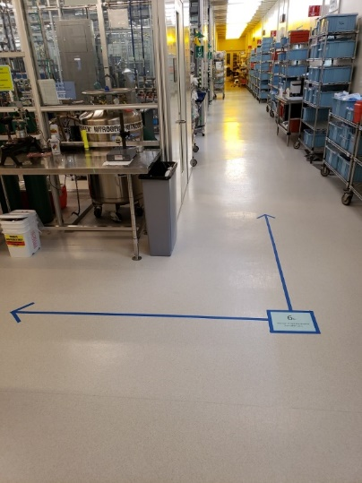
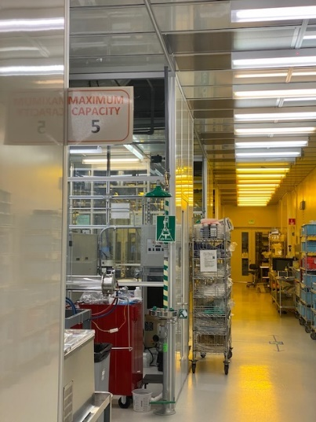
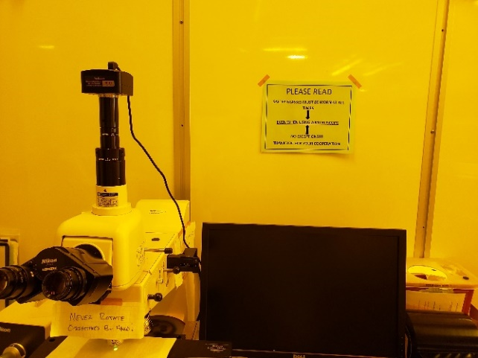
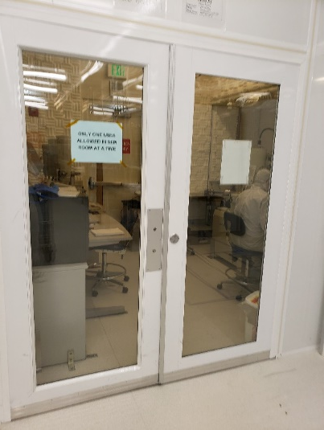
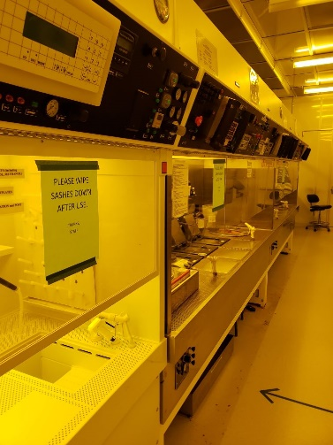
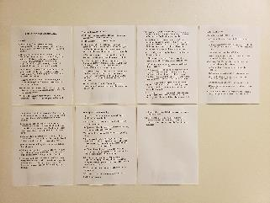
Microscope use reminders including use of safety glasses and cleaning after use
Social distancing markers
Bay occupancy signs
Room occupancy signs
Sash cleaning reminder
Detailed laboratory protocols
Keeping glasses on while using scope reminder

